Slide 1

Velox Custom
Simon Hofer

Slide 2








Velox Custom
Frontend UI
Dynamic Behavior / UX
3D Engine
Backend / Server

Slide 3
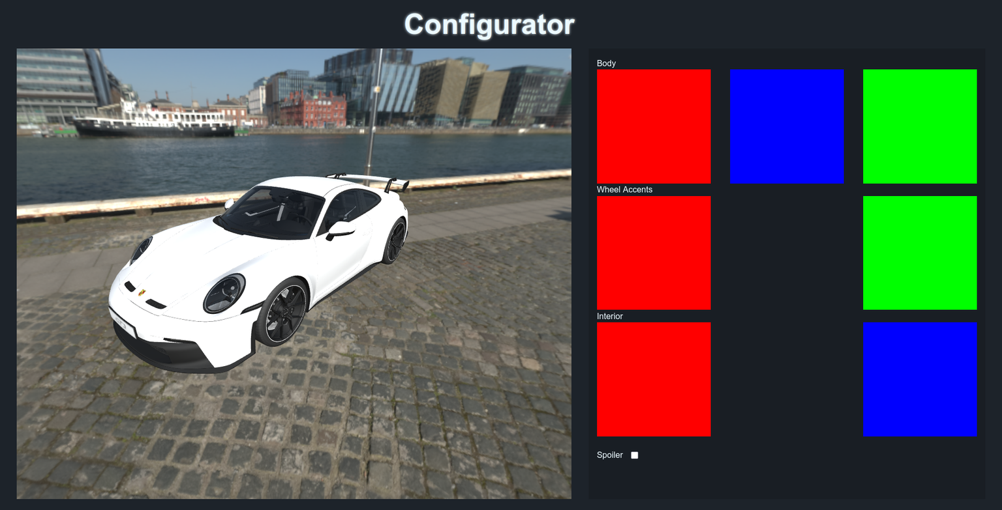
Velox Custom

Slide 4
Transition :)

Slide 5
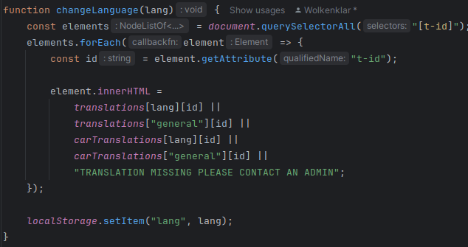
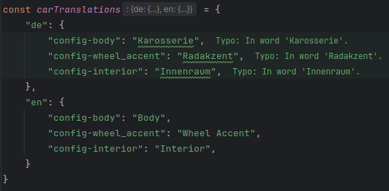
Velox Custom

Slide 6
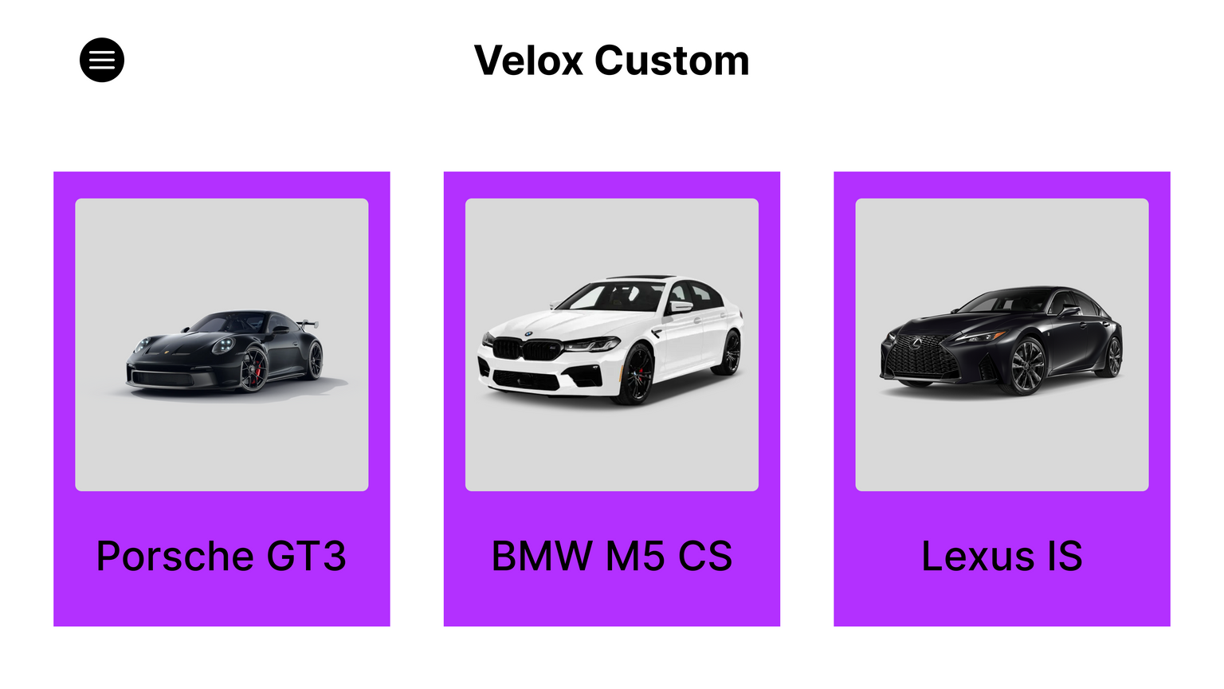
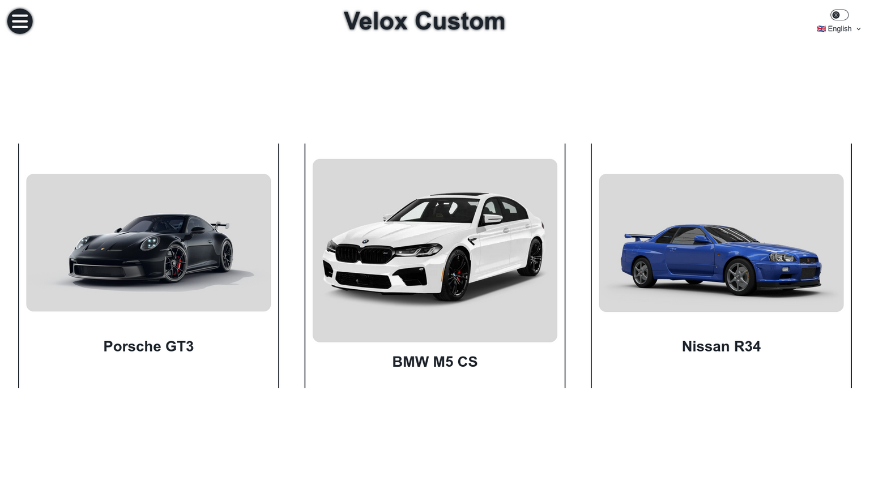
Velox Custom

Slide 7
Velox Custom

Slide 8
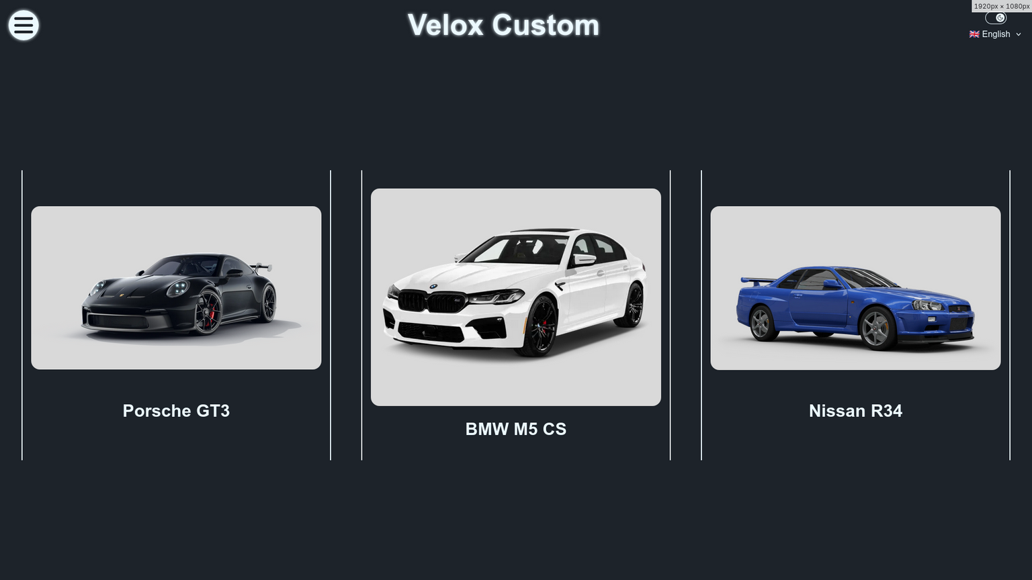
Velox Custom

Slide 9
Velox Custom
Live Demo

Slide 10
Velox Custom

